Slide 1

Vestiges of Eternity <Final/AI>
Futuristic Dystopian Dungeon Roguelike
Tyler Crawford, Steven Keppinger, Matthew Spiker, Kaue King

Slide 2
Project Roles:
Project Manager (Tyler)
Core Mechanics (Steven, Matthew)
Physics, Enemy AI, Attacking and Taking Damage, Room Generation
Level/Enemy Design (Tyler, Steven)
Item Design (Matthew, Kaue)
UI/HUD/Look and Feel (Tyler, Kaue)
Menus, Inventory, Indicators, Options
Other:
Art (Tyler, Kaue) , Sound (Steven), Story (Steven)
Bosses, Tile Mapping, Obstacle Setting For Backend
Item Sprites + Item Viability

Slide 3

What we Promised:
Dungeon Generation
Fleshed Out Gameplay
More Enemies
Fully Fleshed Out UI
NPCs interactions

Slide 4

Technical Triumphs:
Dungeon Generation
Generated Map UI
Enemy Variety
Flexible RNG based Item pools
Mob spawn arrangements for specific rooms
Configurable NPC interactions

Slide 5
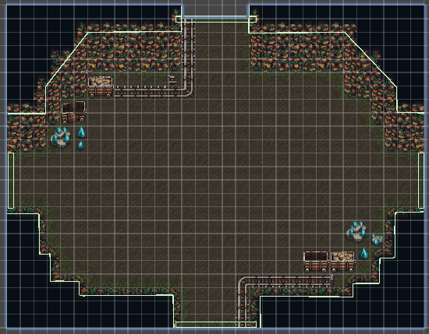
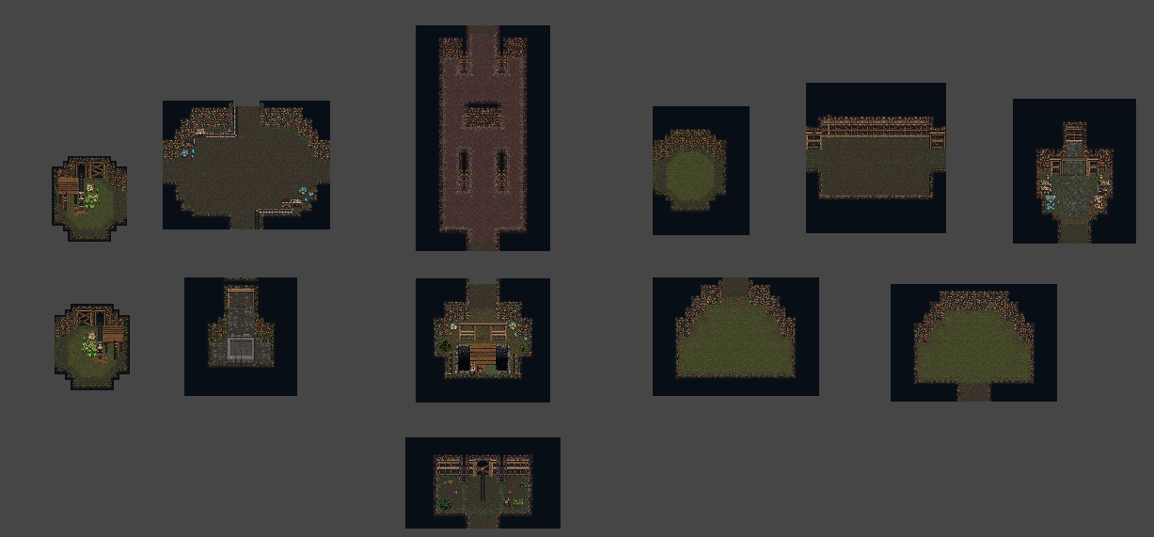
Dungeon Generation:

Slide 6
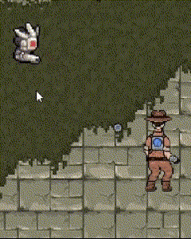
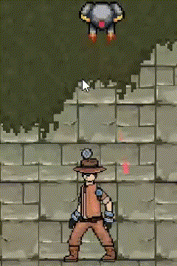
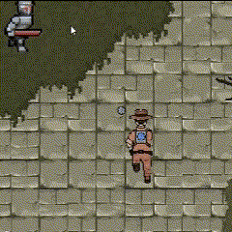
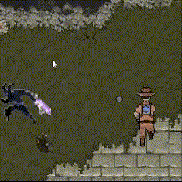
Our Enemies:
Sniper Drone
Assault Drone
Melee Chaser
Melee Charger

Slide 7
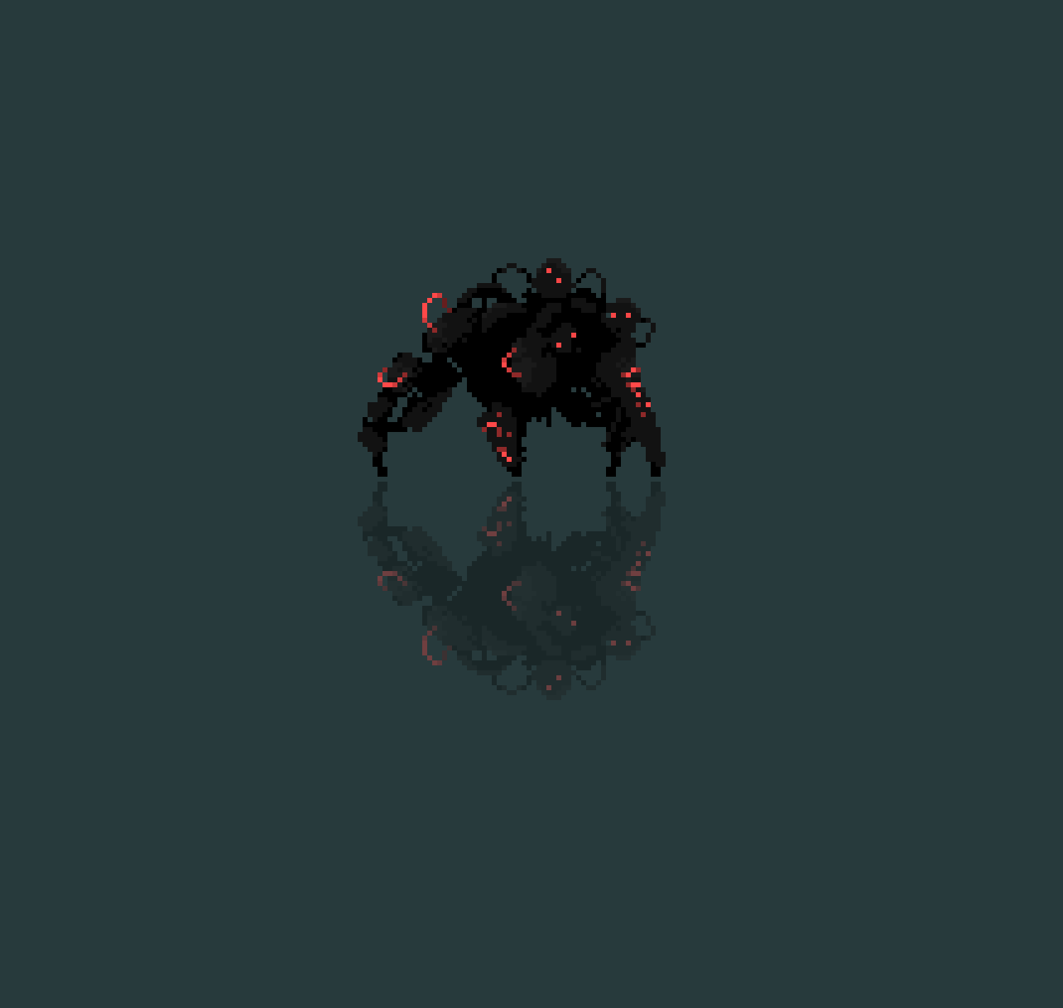
Boss Plan:
Mechanical spider
Decision Tree for attacks depending on:
Boss health (stage)
Player health
Spawn other enemies
Bullet patterns more reminiscent of the bullet hell genre (circles, spirals, etc.)

Slide 8

User Feedback:
We had 10-12 responses on our google form, and it provided us some valuable insights to consider for our game.
"Clipping" was a problem with regards to dashing into terrain (Unstuck button added) + visual bugs with player and terrain
There was a need for UI to clarify the control scheme
How the dashes were controlled needed to be changed
Enemy Variety was needed

Slide 9

What Didn't Go As Planned
Boss Fight UI + Sprite Animations
Full end to end balancing and "Alpha testing"
Audio with menus
Endgame Credits
Unity Trolling
Story Writing and Integration

Slide 10
DEMO
https://drive.google.com/drive/u/1/folders/15y6Z0Mh8O8HLyRXDzQ3T0hvPre8TeN02 (V5 is latest)

